Slide 1
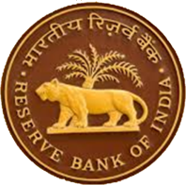
भारतीय रिजर्व बैंक Reserve Bank of India A career With RBI

Slide 2
About Us
The Reserve Bank of India was established on April 1, 1935 in accordance with the provisions of the Reserve Bank of India Act, 1934.
The Central Office of the Reserve Bank was initially established in Calcutta but was permanently moved to Mumbai. We have 31 offices including sub-offices located across the nation.
We are a full-service Central Bank handling a variety of functions.

Slide 3
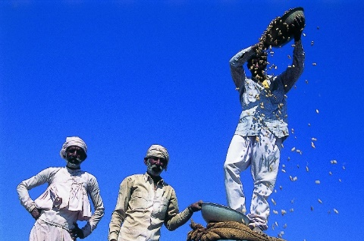
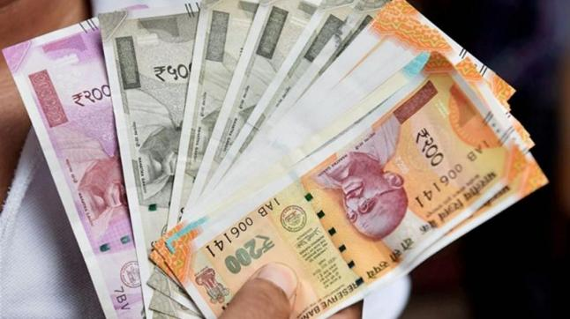
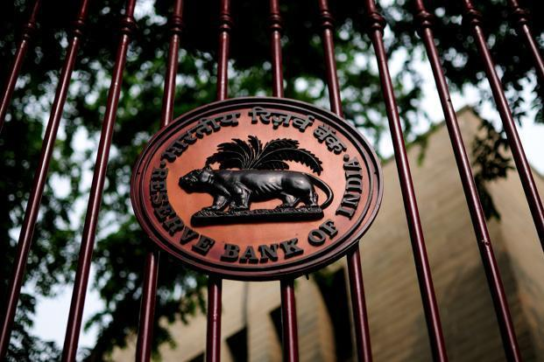
RBI does much more than you thought !
Supervisor of the Financial System
Monetary Authority
Developmental & Regulatory Role
Currency Management
Overseeing Payments & Settlements Systems
Banker to the Government & Banks
Foreign Exchange Management

Slide 4
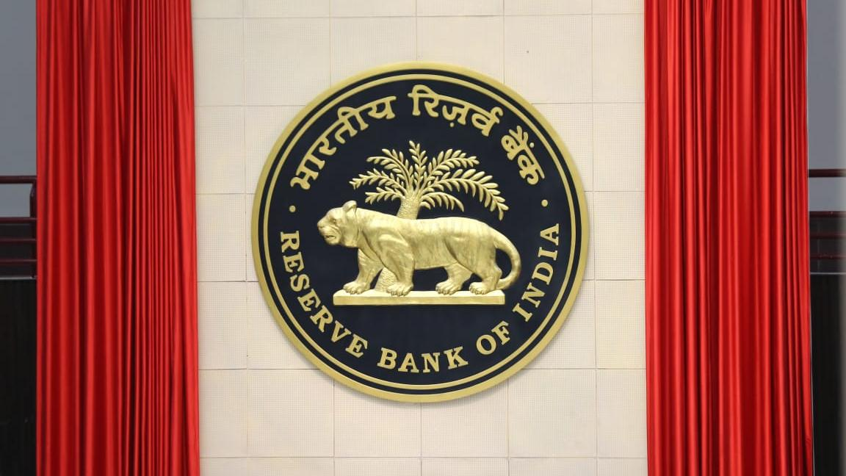
Opportunities at RBI- A Career in Finance and Public Policy
Life with RBI is not just another job.
It’s a commitment. Commitment to serve the nation, where your decisions make an impact on the way the economy and the financial sector in the country evolves.

Slide 5
What to expect in a career at RBI?
Team up with the best minds
Spearhead reforms
Touch the lives of millions
Do research that matters
Join the global mainstream

Slide 6
Highlights of work at RBI
Intellectual Fulfillment
Stability
Skill Enhancement
Social Esteem
Think Together
Belongingness
Equal Opportunity Employer
Make a Difference
Supportive HR Climate
RBI
Rewarding Career
Attractive Compensation

Slide 7
Perquisites & Benefits
In addition to the monthly emoluments, the Bank offers various perquisites and benefits* such as :
Bank's accommodation (subject to availability)
Reimbursement of expenses for maintenance of vehicle for official purpose, newspaper, telephone charges, book grant, allowance for furnishing of residence, etc. as per eligibility.
Free dispensary facility besides reimbursement of medical expenses for OPD treatment/hospitalization as per eligibility.
Leave Fare Concession, Loans and Advances at concessional rates of interest for Housing, Vehicle, Education, Consumer Articles, Personal Computer, etc.
* subject to eligibility and extant terms & conditions

Slide 8
Work Culture
RBI emphasizes on its accommodative work culture and boasts of a bouquet of employee friendly policies including those designed especially for lady employees.
Women-Centric Policies
Maternity benefits
Special hardship leave
Flexi-work hours
Office pick-up and drop facility (for odd working hours)

Slide 9
Our Presence
The RBI has 31 Offices and sub-offices - most of them in state capitals. Its Central Office is in Mumbai. It has two training establishments - one each in Chennai and Pune. In addition, it also has four Zonal Training Centres, one each in Mumbai, New Delhi, Kolkata and Chennai.
During your career, you will get a chance to work in different departments and centers.

Slide 10
Grade ‘B’ -DR-General Stream Selection Process
a) Phase I - Objective Type MCQ Test with 4 modules viz. General Awareness, Quantitative Aptitude, Reasoning, English Language
b) Phase II – Mixed Pattern - Paper I Economic & Social Issues Paper II English Descriptive Paper III Finance & Management
c) Interview
Note: We also have recruitment in specialised streams. For details, please visit our website https://rbi.org.in

Slide 11
How to apply?
Candidates are advised to ensure their eligibility for the posts before applying.
Candidates are required to apply ONLINE only through the Bank's website https://rbi.org.in
Visit the URL “Recruitment for the post of “Officers in Gr.’B’ (DR) General/DEPR/DSIM” on Bank's website i.e. www.rbi.org.in >Opportunities@RBI >Current Vacancies > Vacancies and click on the hyperlink “Online Application Form”

Slide 12
Thank you!

